Slide 1
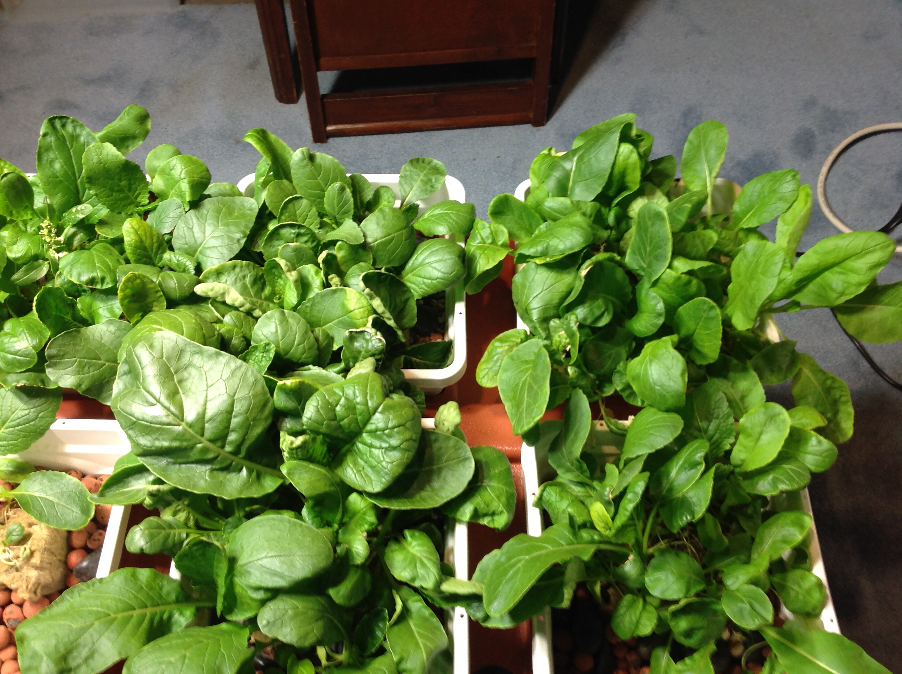
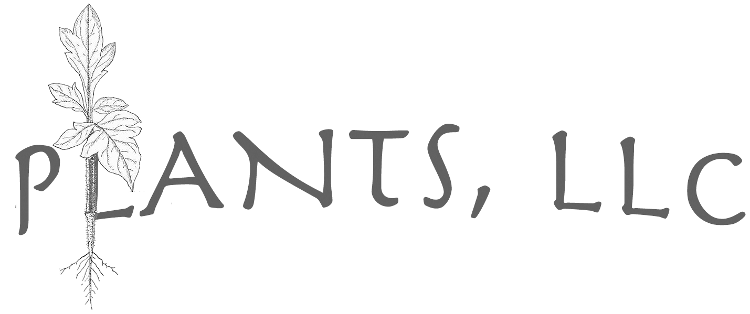
Intro to Hydroponics
Laurie Ruberg
STEAM Partnership: 3D Printed Hydroponics

Slide 2
Hydroponics has been around for over 2000 years… but today’s technologies give it a new look!

Slide 3
What is hydroponics?
Growing plants hydroponically means that:
Plants grow without soil…
…in a water-based nutrient solution
…in materials that give plants the support they need…to thrive in a growth chamber with a delivery system that gets the nutrient solution to the plant roots…
…with either natural or artificial lighting.

Slide 4
Hydroponic: Advantages / Disadvantages
Healthier plants – having a near-perfectly balanced diet
Healthier consumers – less need to use herbicides, fungicides, and pesticides
Higher Yields – without water and nutrient stresses, plants grow faster and can be grown more compactly
Conservation – preventing evaporation and runoff
Year-round production schedule
Initial set up costs can
be high
Because plants share nutrient fluids, diseases and pests can quickly move from plant to plant
Maintenance requirements can increase, depending on the system used and crop
A power outage can destroy a crop
Initial set up requires technical knowledge, time, and commitment

Slide 5
Types of Hydroponic Systems
Passive
Active
Water Culture
Media-Based

Slide 6
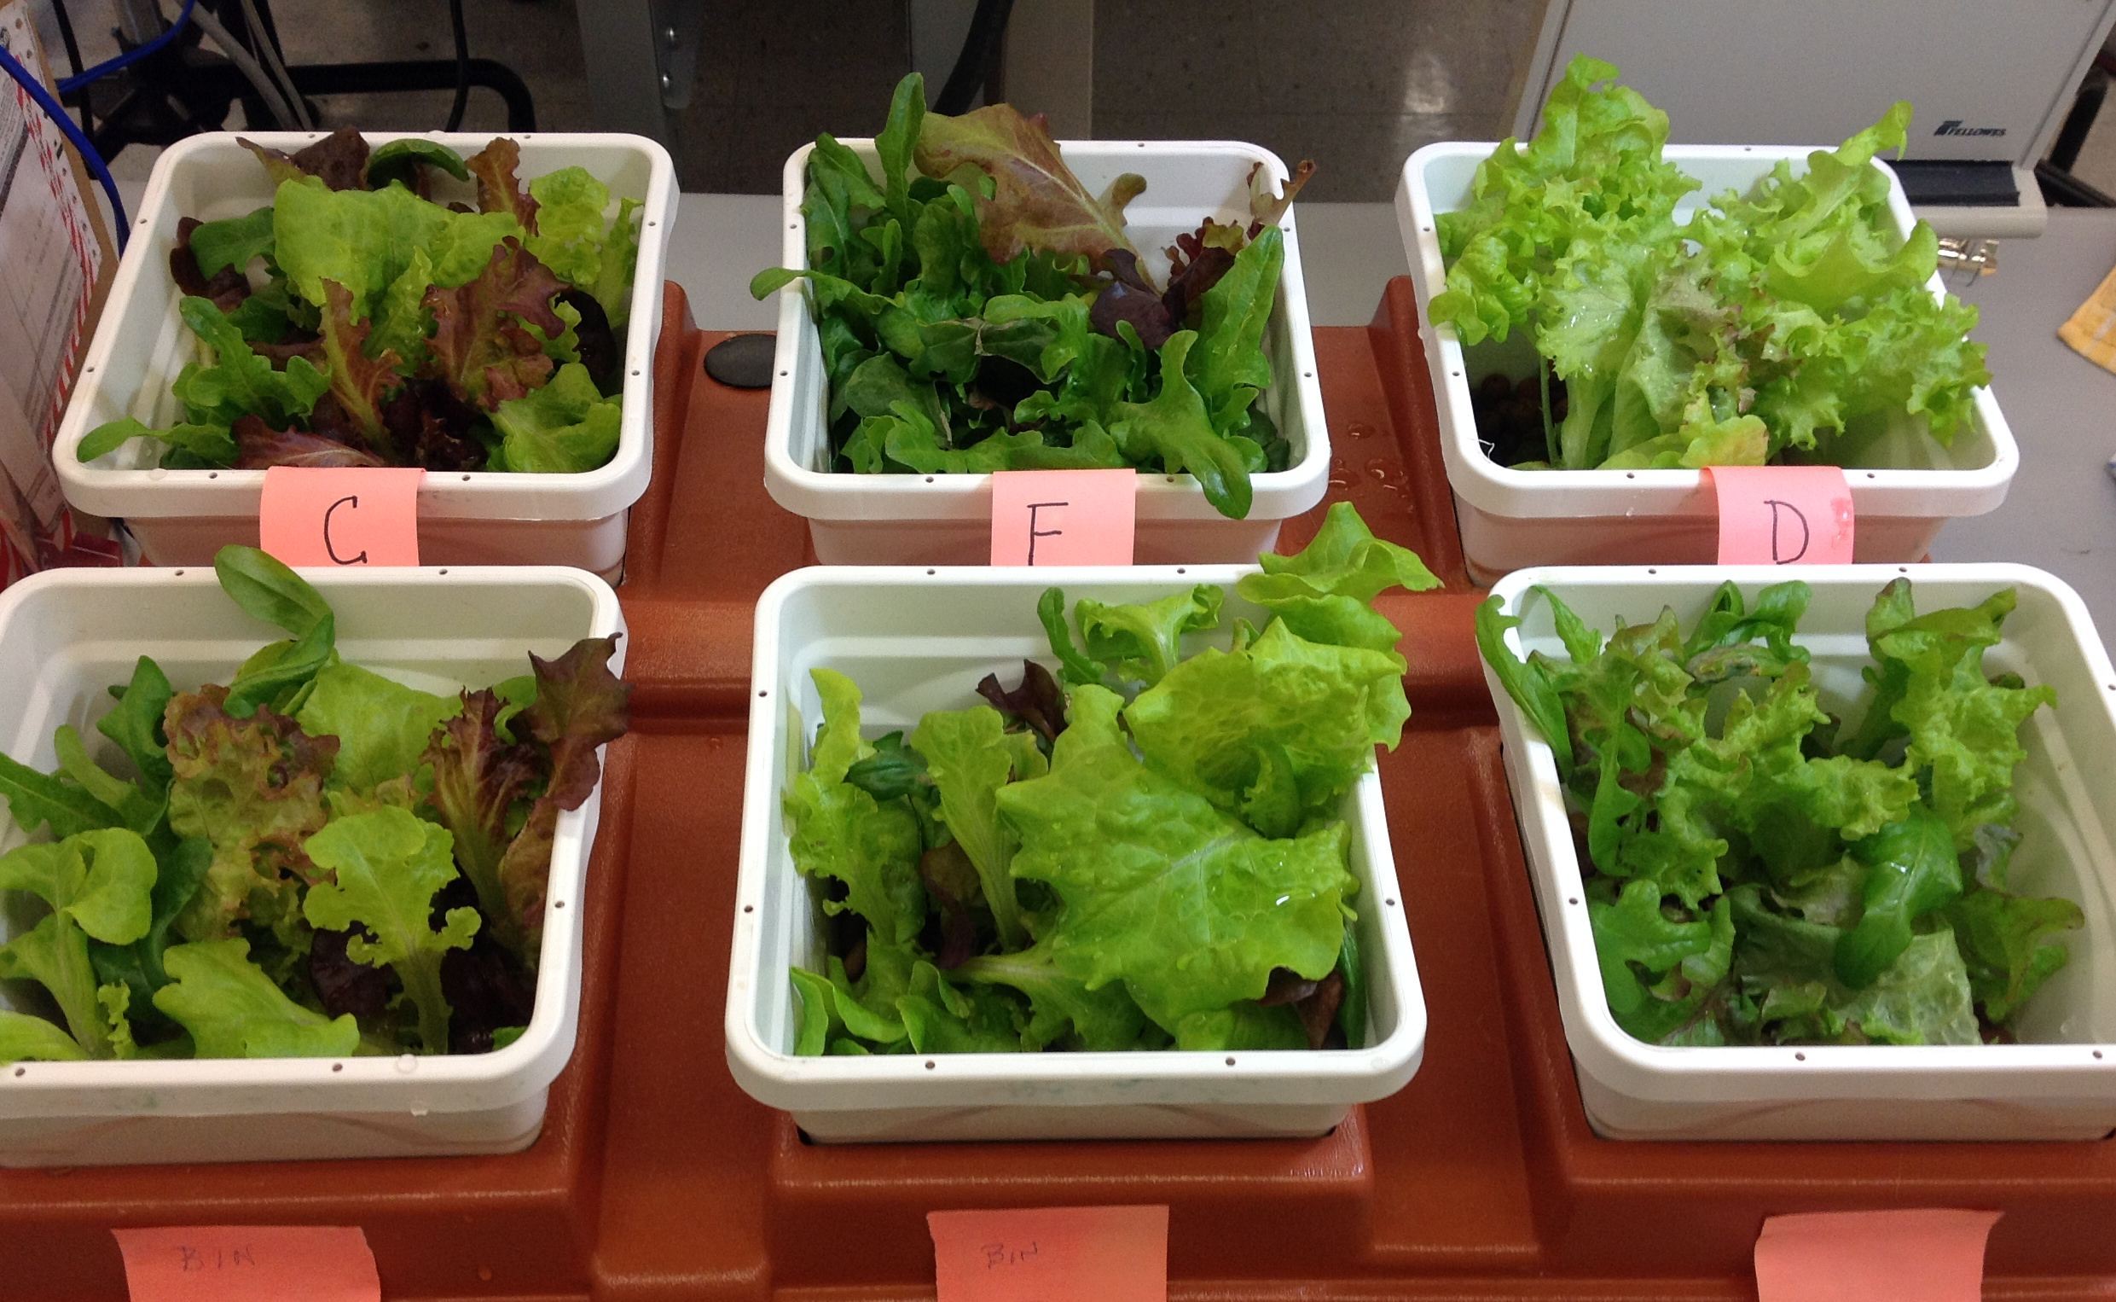
Emily’s Garden

Slide 7
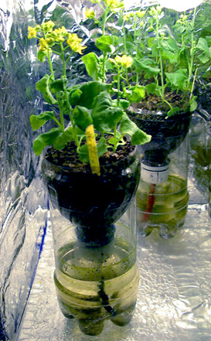
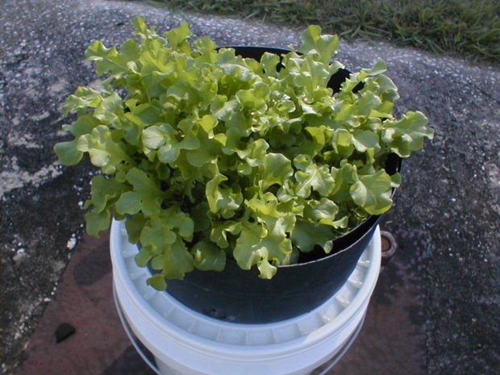
Wick-based systems

Slide 8
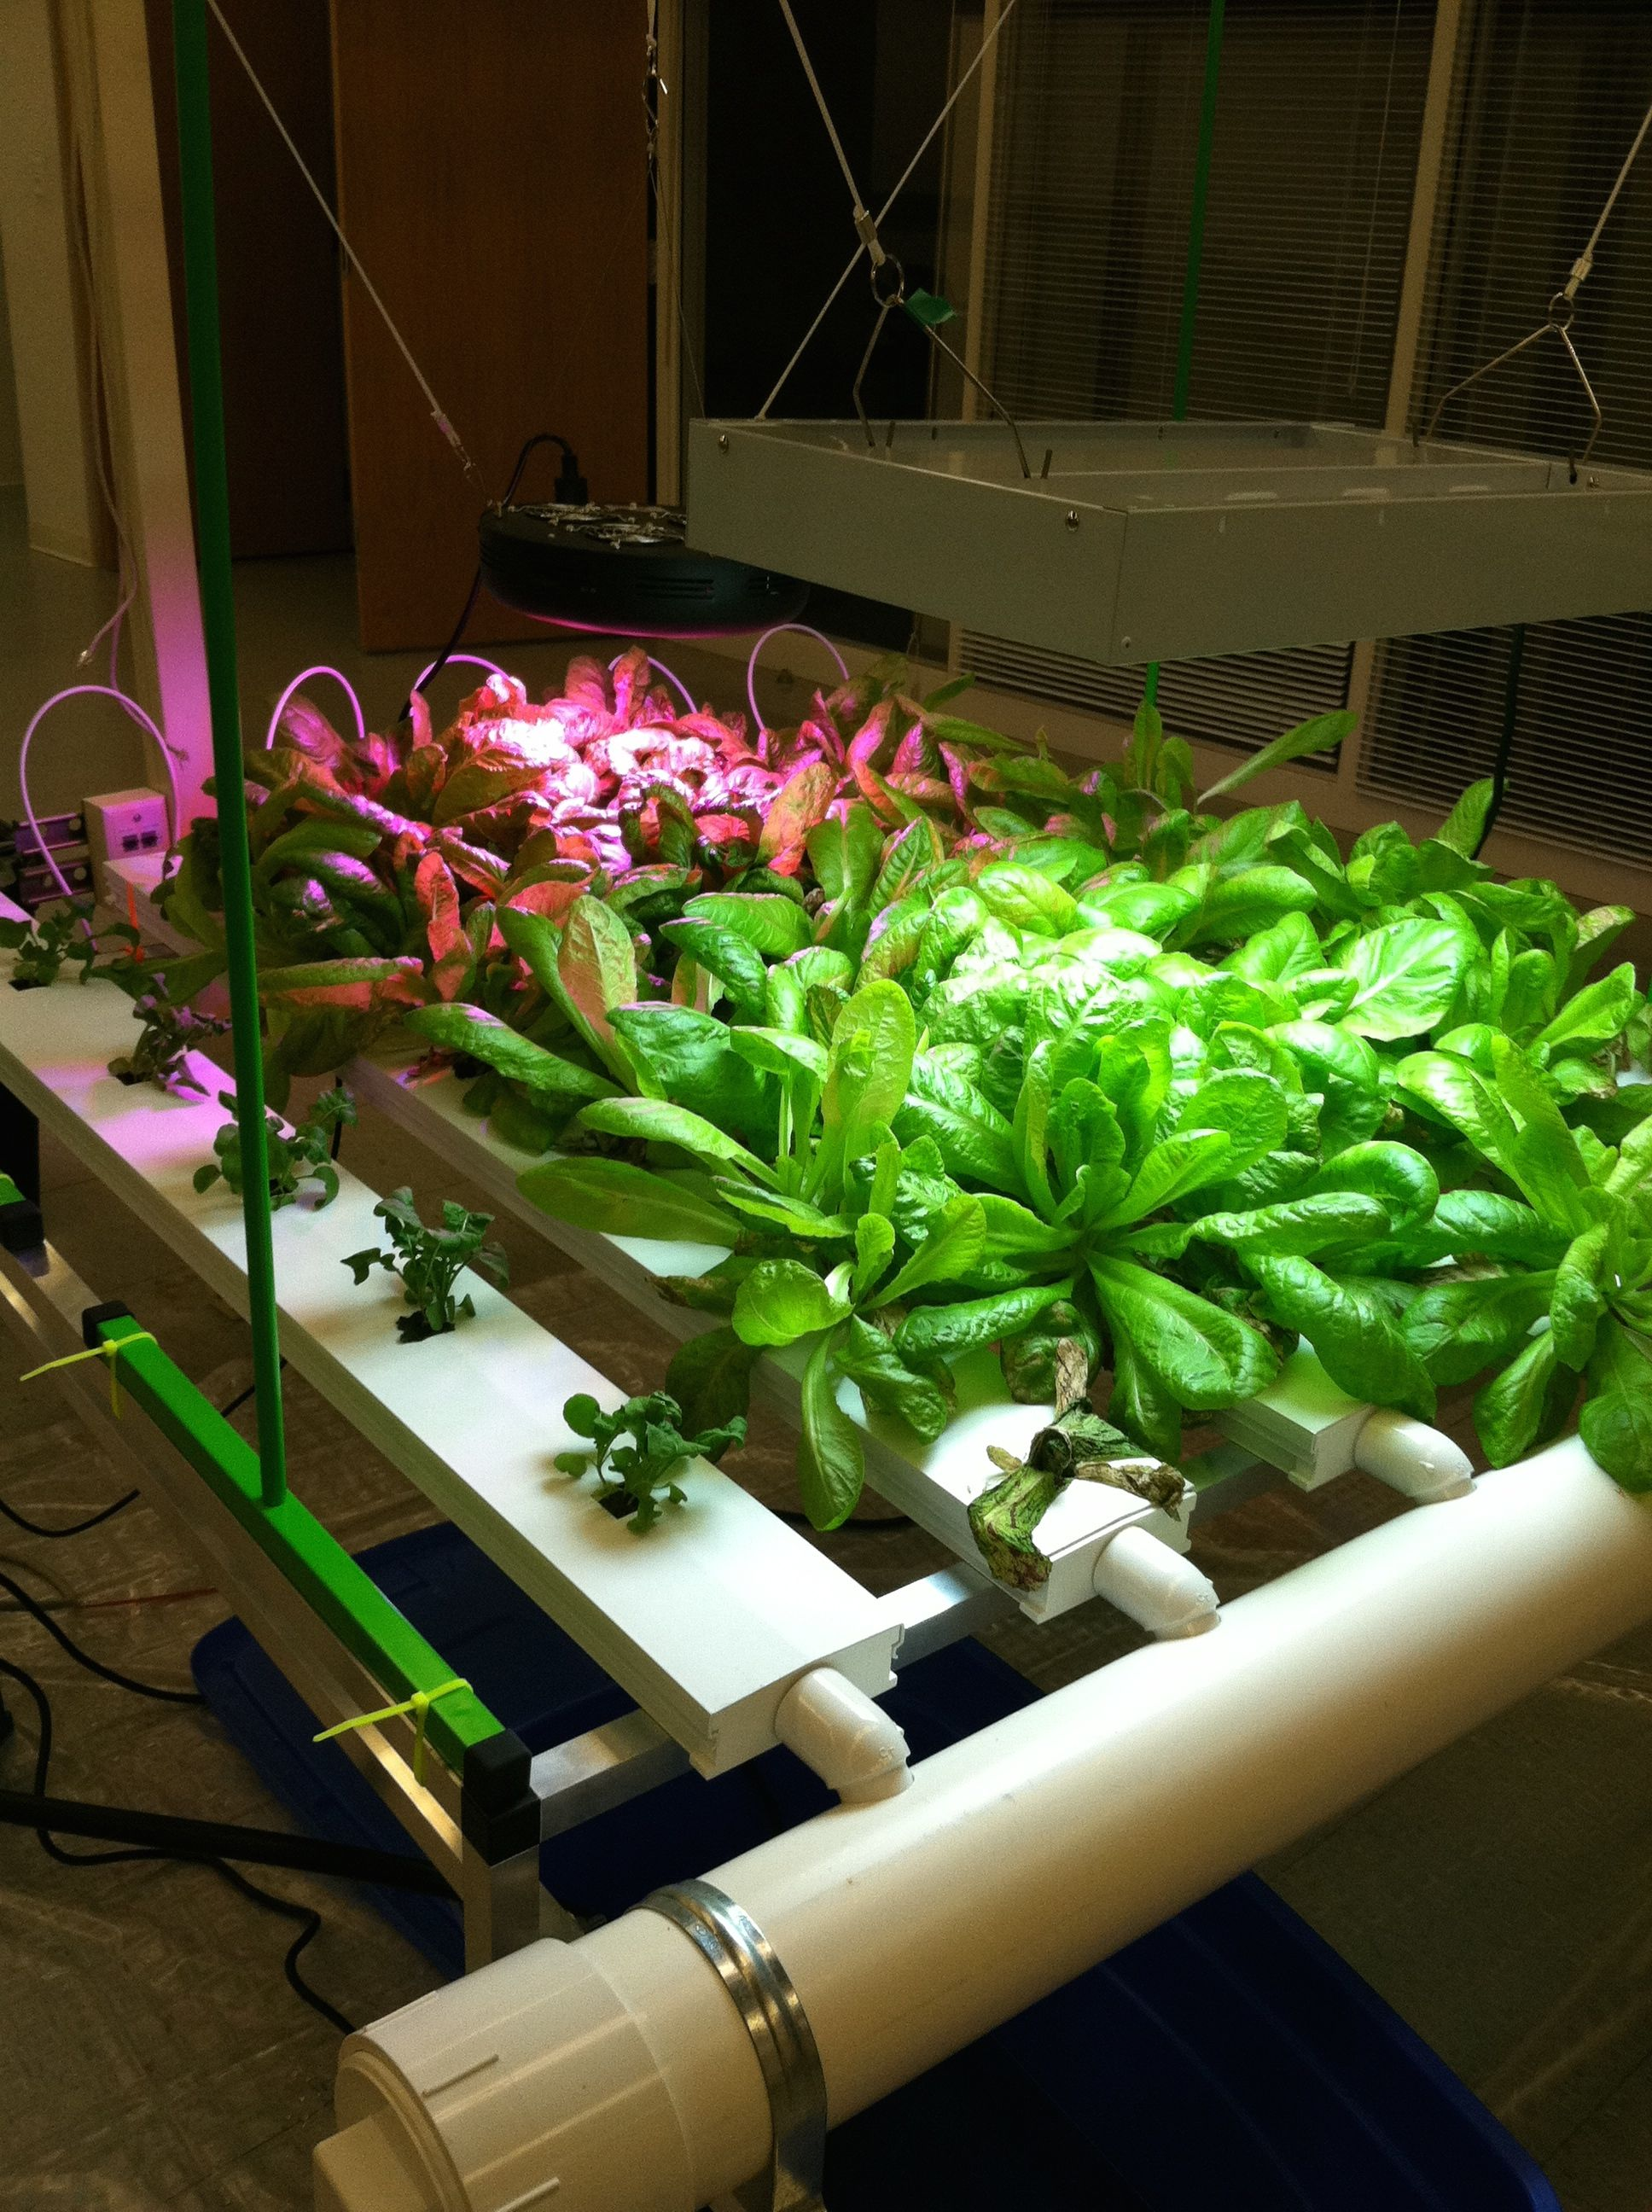
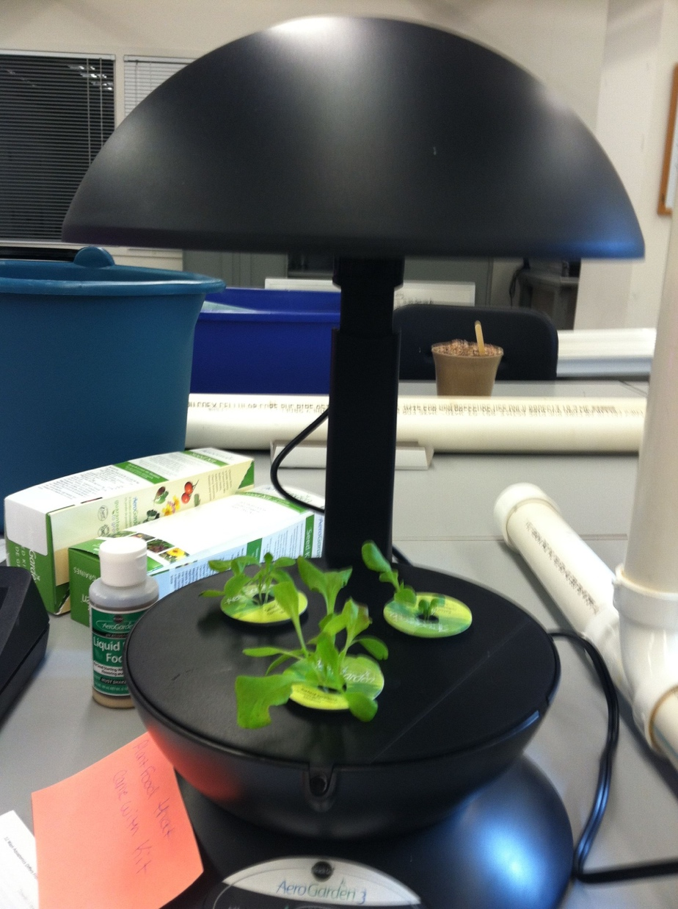
NFT System
Active Raft System

Slide 9
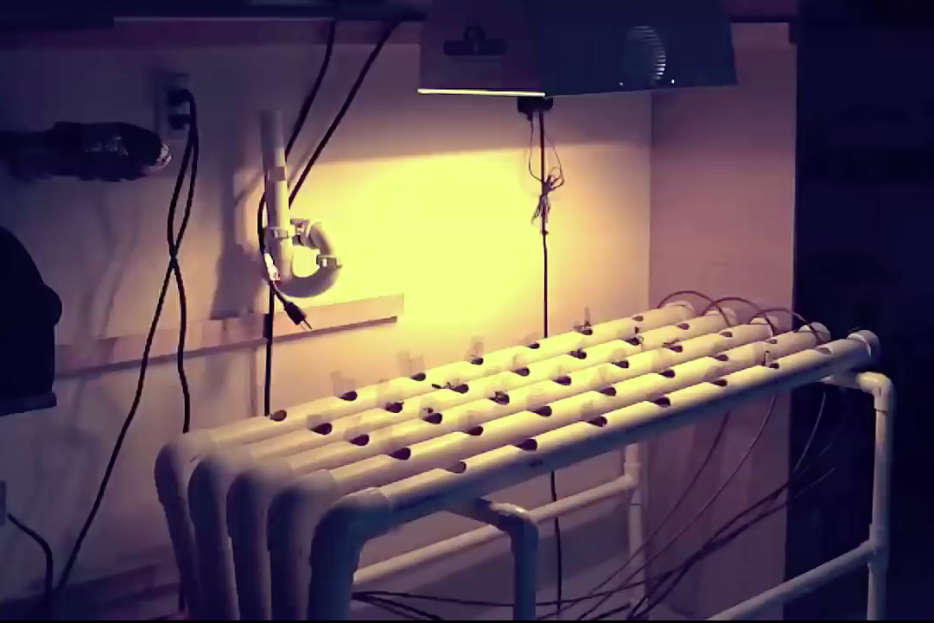
DIY Hydroponic System

Slide 10
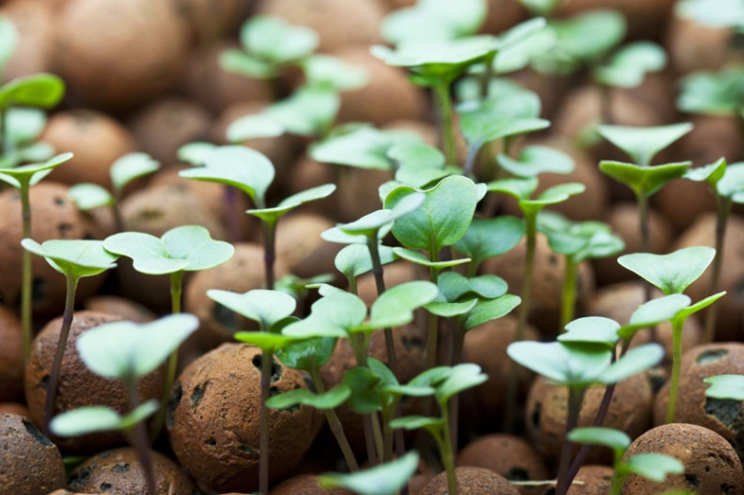
What to know to be successful with your hydroponic system

Slide 11
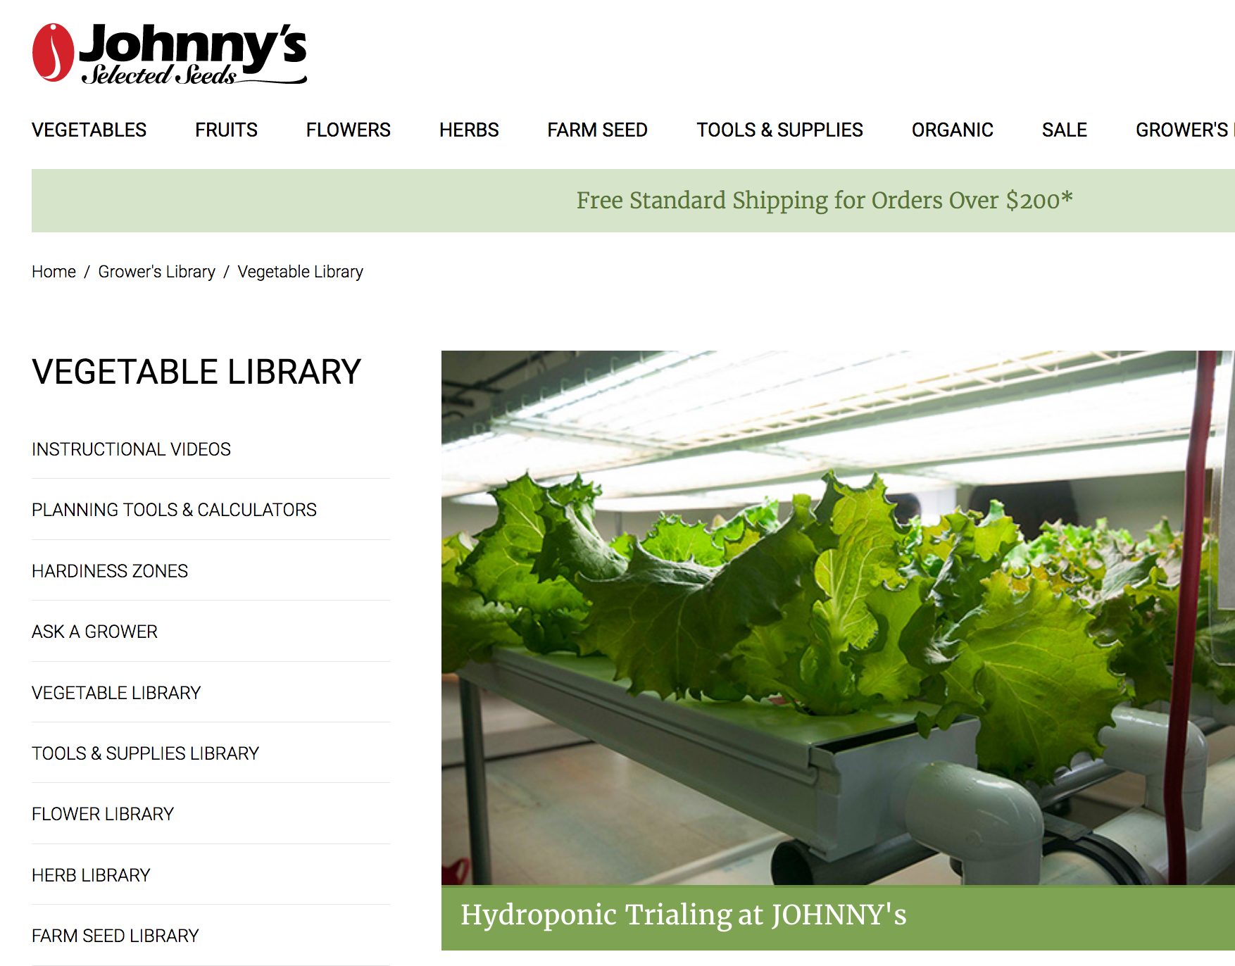
Select seed varieties that do best in a hydroponic culture

Slide 12
Maintain optimum conditions for your plants
Consider plant’s ideal…
Temperature
Light intensity
Spacing
Investigate your plant’s
life cycle,
structural needs,
pollination and reproduction processes, and
disease/pest vulnerabilities/resistances

Slide 13
Explore plant mineral requirements
The primary mineral nutrients plants require are nitrogen (N), phosphorus (P), and potassium (K).
Secondary mineral nutrients include calcium (Ca), magnesium (Mg), and sulfur (S).
Plants also need these micronutrients boron (B), copper (Cu), iron (Fe), chloride (Cl), manganese (Mn), molybdenum (Mo), and zinc (Zn).
See interactive periodic table of plant nutrients at: http://www.cropnutrition.com/nutrient-knowledge

Slide 15
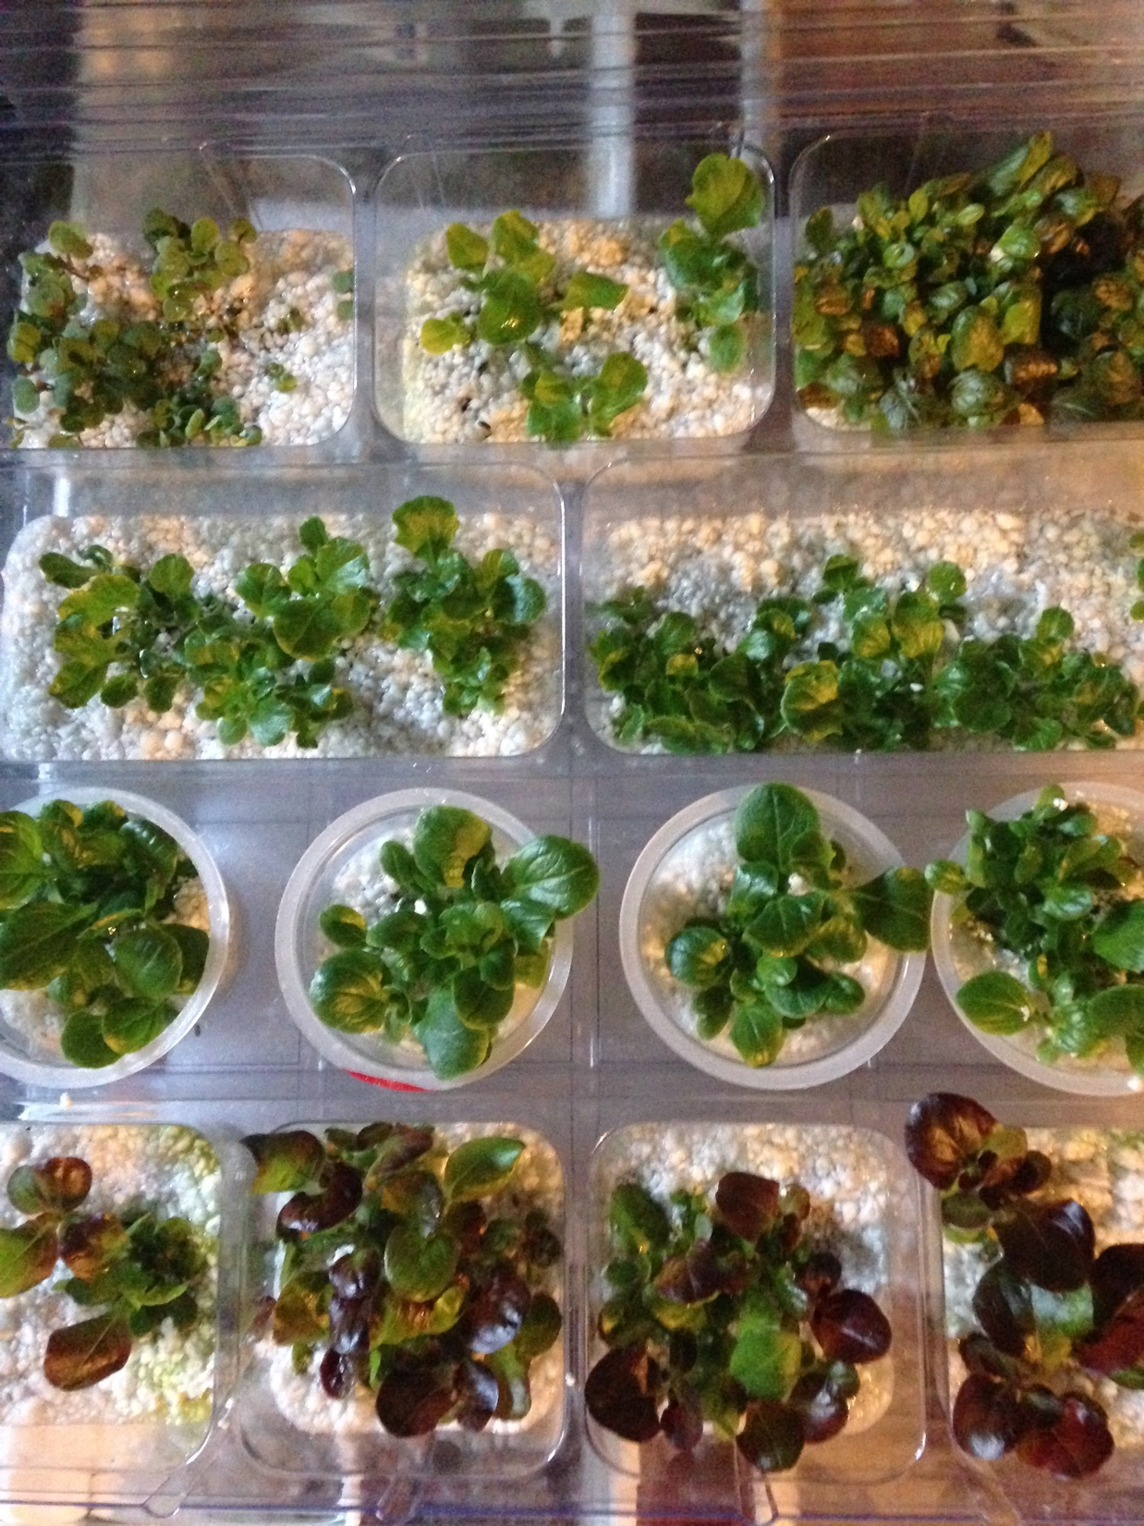
Explore using different materials to support plant growth.
For example,
compare Vermiculite and Perlite as materials for seed germination.

Slide 16
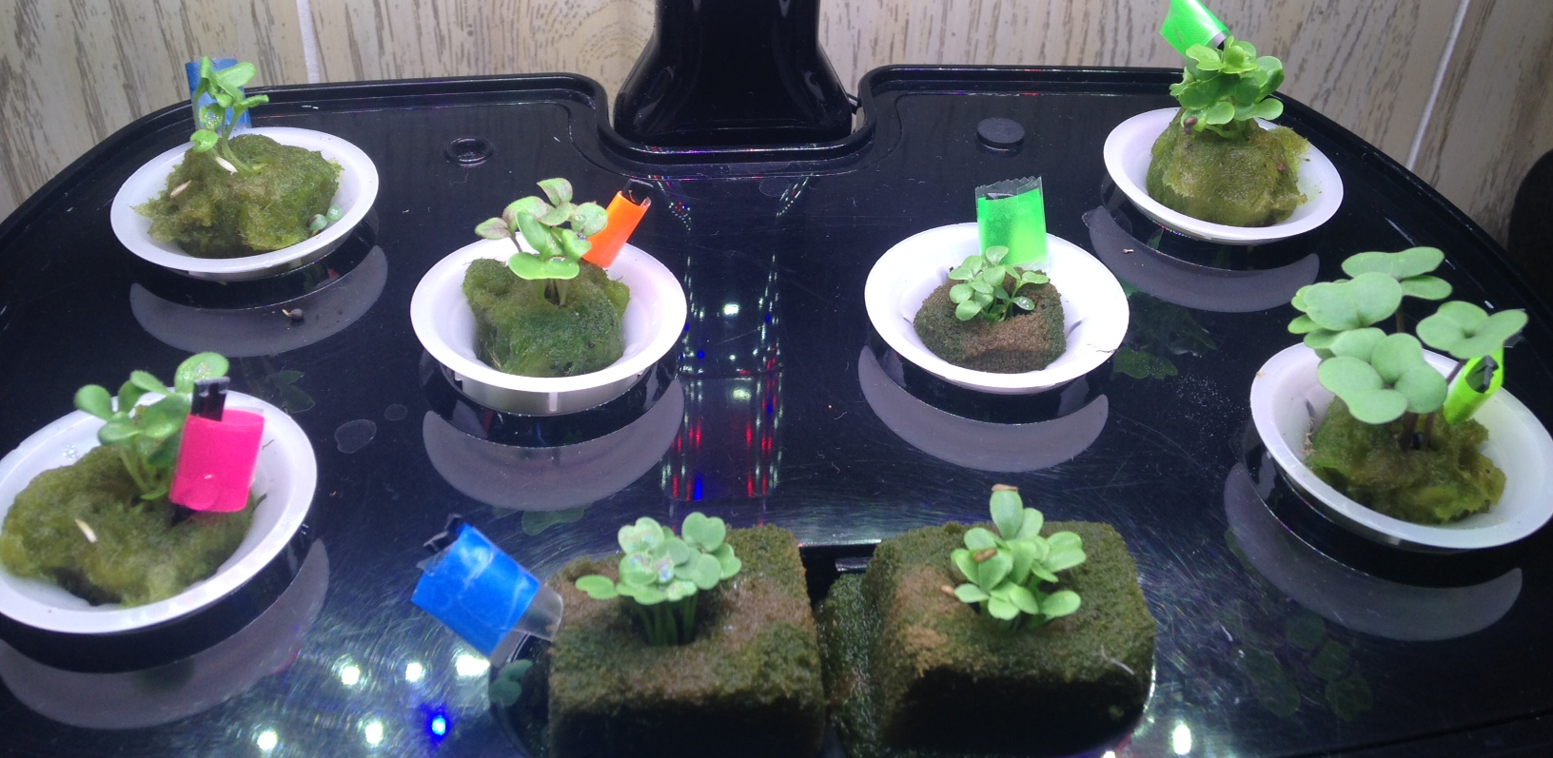
Seedlings in 2 Types of Seed Plugs
Romaine
Nashes Green OG Kale
Outredgeous (red leaf) romaine
Arugula
Summer Crisp
Bambi
Red Russian OG Kale

Slide 17
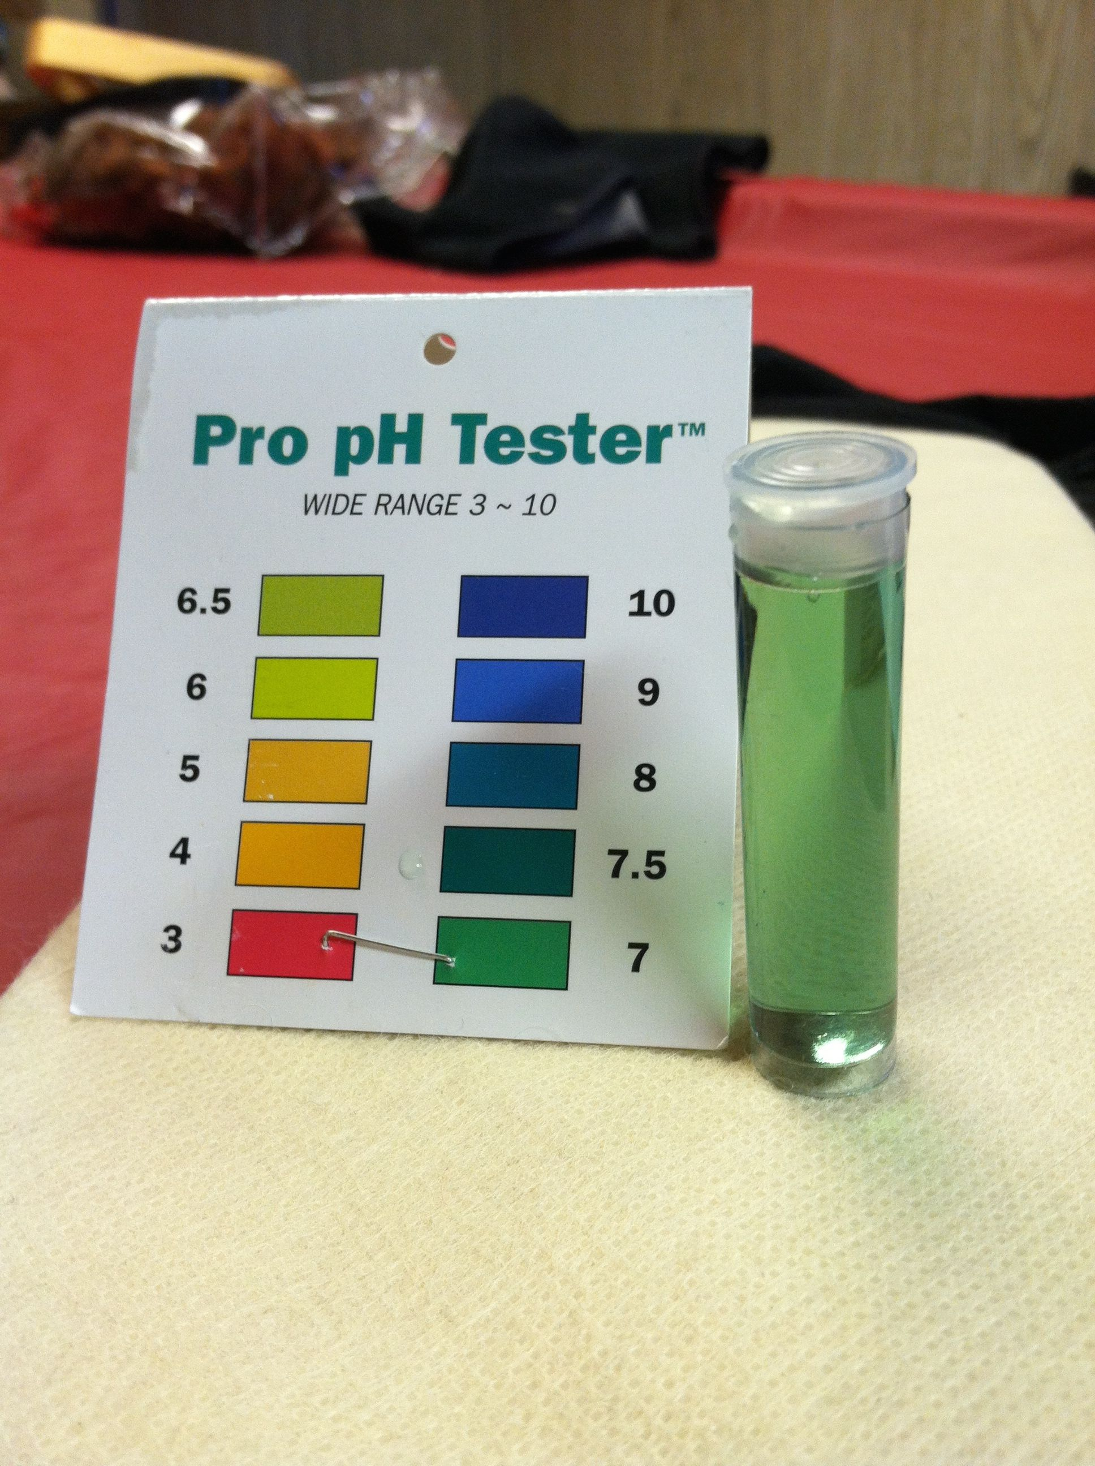
Explore water quality analysis using simple and/or more complex technology tools.

Slide 18
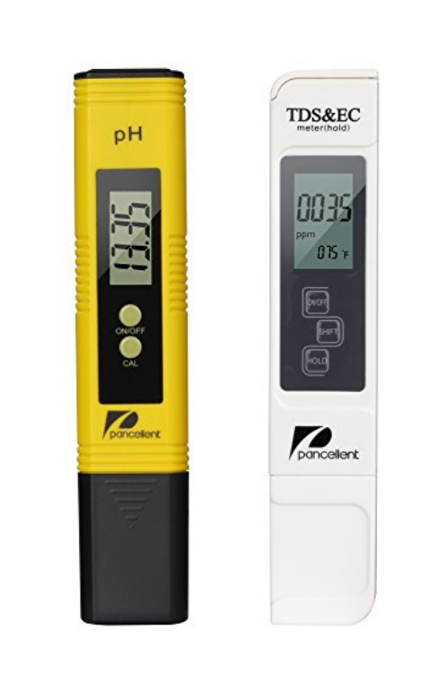
Temperature, EC, pH Meter

Slide 19
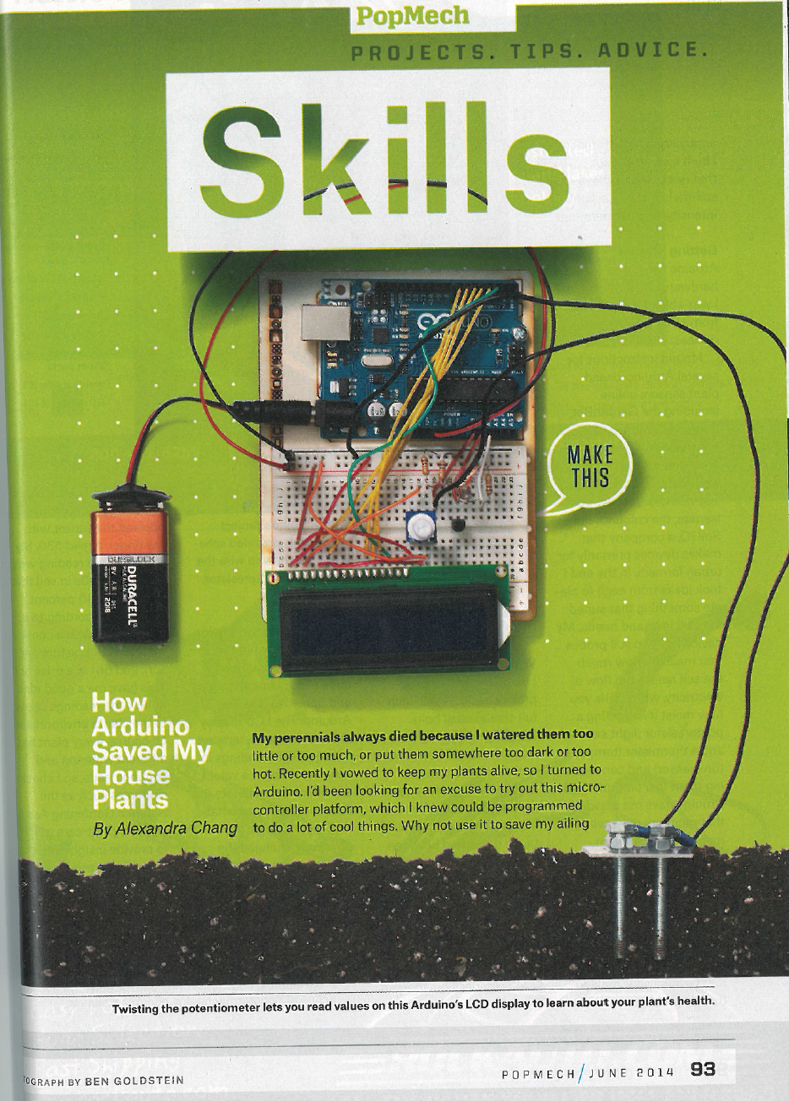
You may want to design your own Arduino controls to monitor hydroponic system functions and processes such as:
pH
Temperature
Electrical conductivity
Water level
Data logging

Slide 20
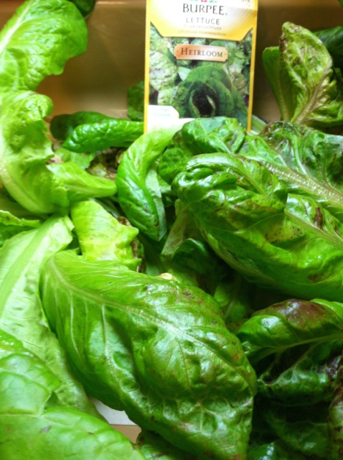
Compare & contrast the characteristics of different plant species and varieties.

Slide 21
OUTREDGEOUS Romaine Lettuce Lactuca sativa

Slide 22
ARUGULA - Arugula Rocket

Slide 23
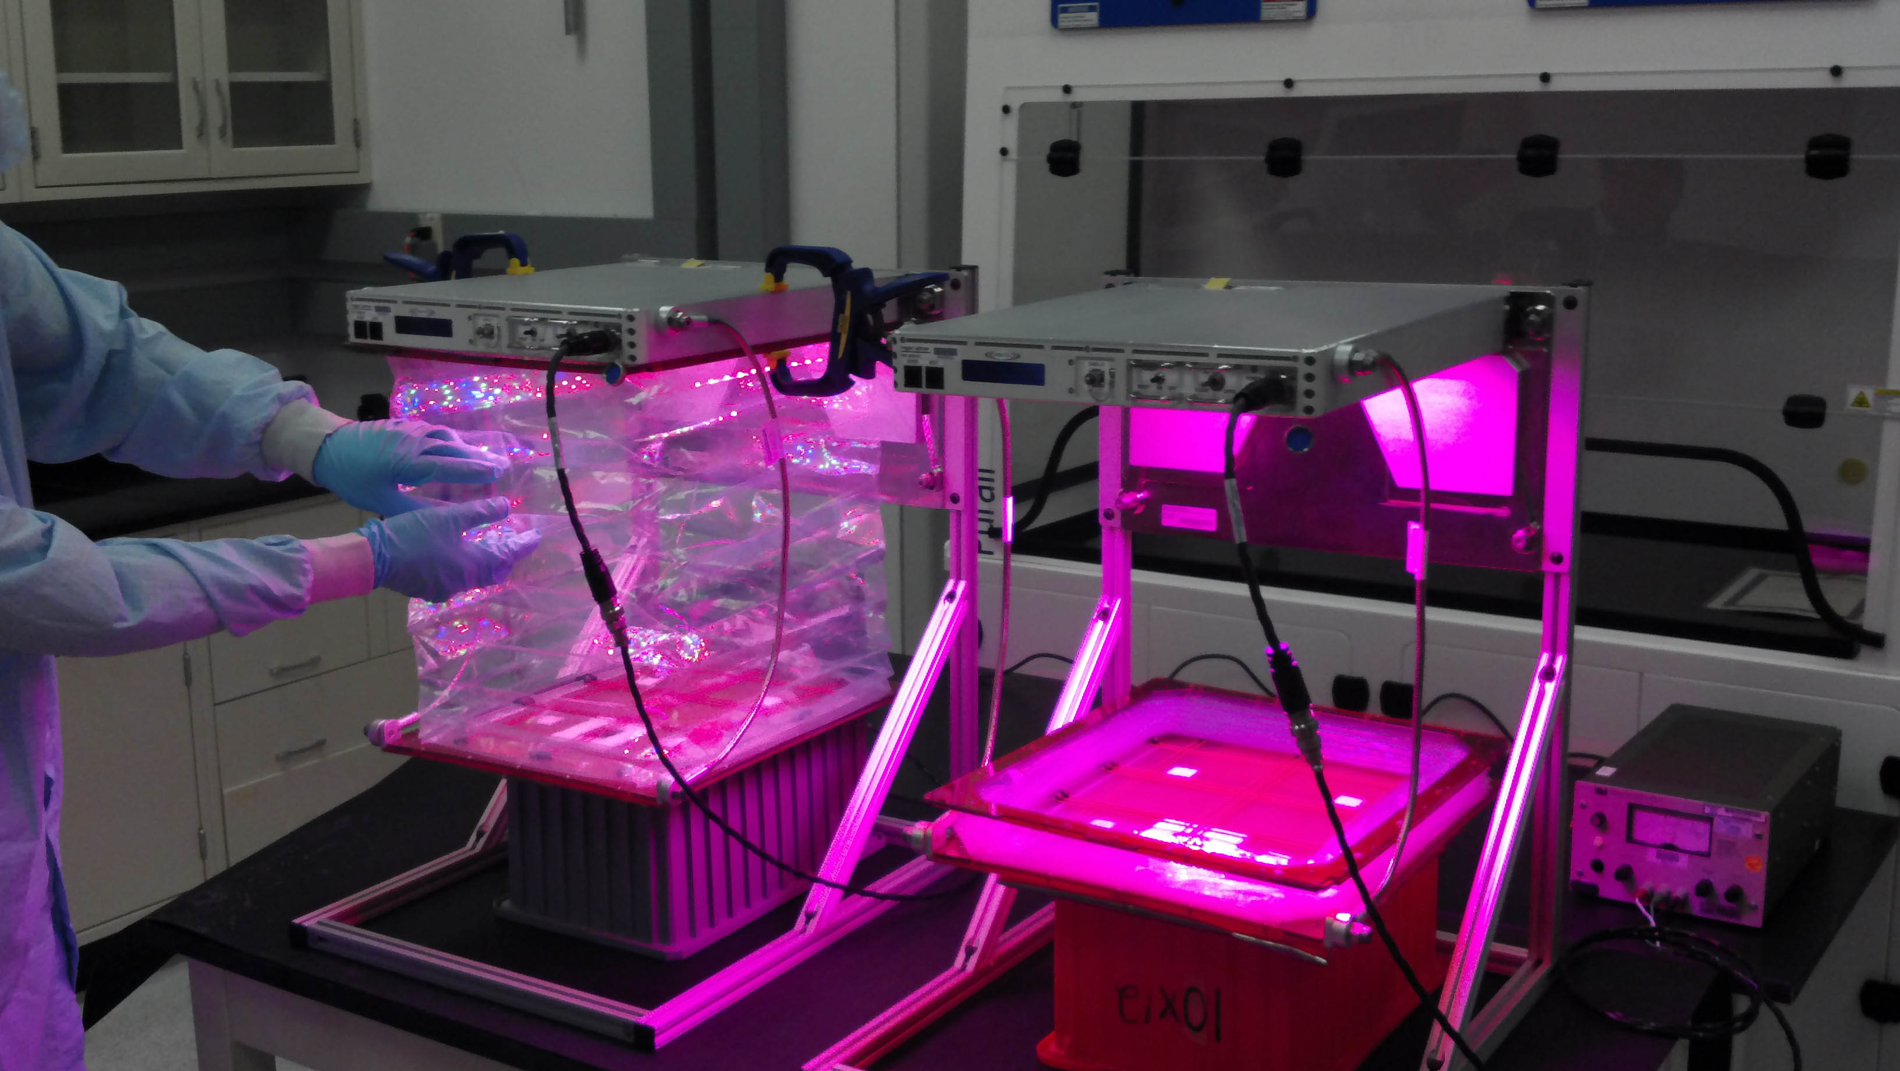
NASA supports humans in space with the Veggie Machine on the ISS
Image credit: NASA Space Station Research

Slide 24
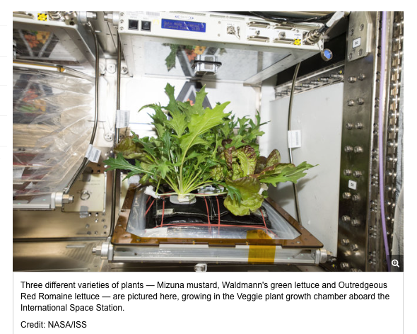

Slide 25
Track Hydroponic Plant Growth Share data on Hydroponics in the Schools Google Drive:
Crop | Week 1 | Week 2 | Week 3 | Week 4 | Week 5 | Week 6 | Week 7 | Week 8 | Week 9 | Week 10 | Week 11 | Week 12
# Seeds
pH
Temperature
Hours of light
Plant size
# Leaves and stems
Weekly plant photo
Plant harvest weight
Plant quality
Plant distribution

Slide 26
Laurie Ruberg, Outreach Coordinator
AmeriCorps VISTA
Families Leading Change
Web: www.familiesleadingchange.org
Email: laurie@ourfuturewv.org
Tel: 304-639-3894

